Slide 1
Please make a copy!
File -> Make a Copy
Remember to include a text file with each of your SQL queries in your project submission

Slide 2
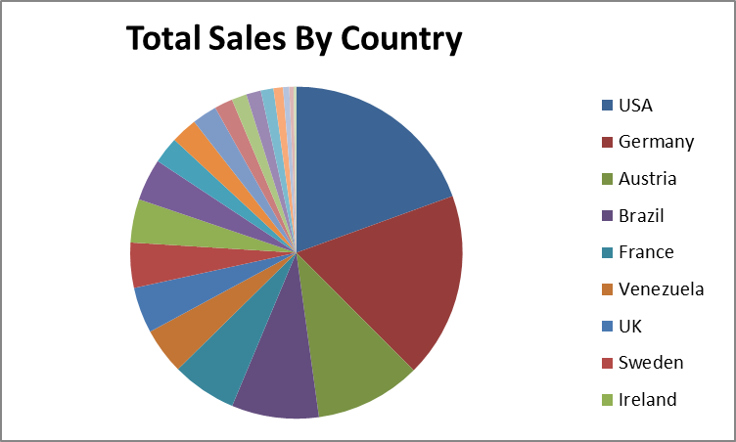
Total Sales by Country
<visualization>
Total Sales by Country
Total Sales is calculated as Unit Price * Quantity
Notes:
<SQL query>

Slide 3
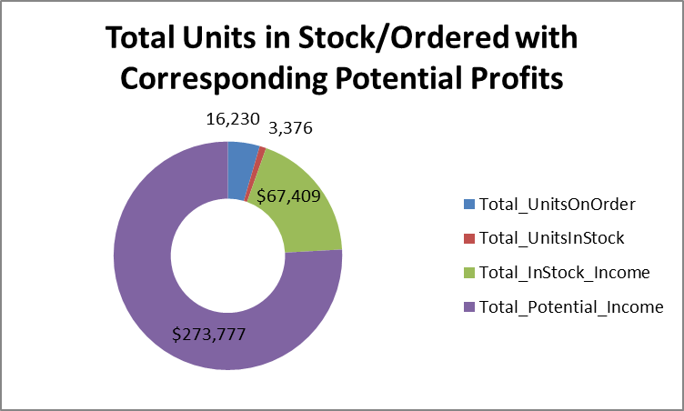
Total Units In Stock/Ordered with Profits
Products ordered that has less than ordered in stock.
Corresponding potential Income based on units Ordered vs Units in Stock.
Notes:
<SQL query>

Slide 4
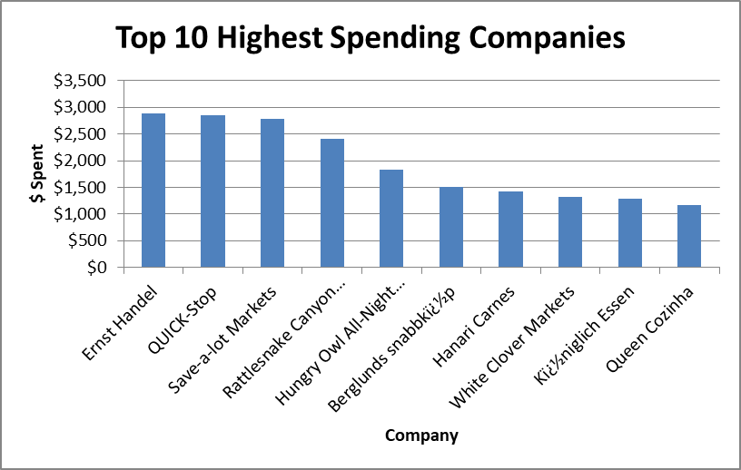
Top 10 Highest Spending Companies
Top 10 companies that Spent the most $
X-axis lists Companies, Y-axis lists $ spent (since beginning of data)
Notes:
<SQL query>

Slide 5
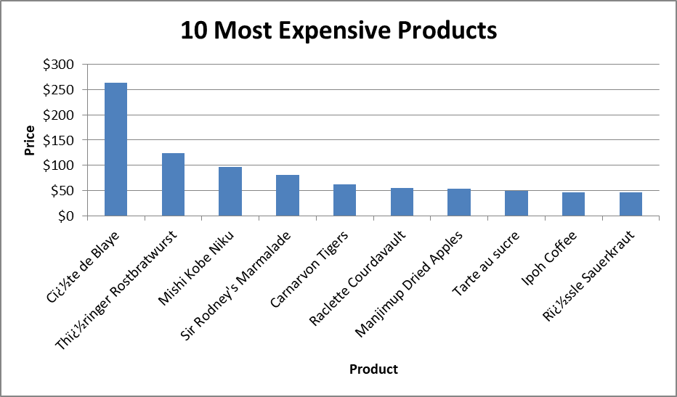
Top 10 Most Expensive Products
<visualization>
10 Most Expensive Products
X-axis is ProductName, Y-axis is Cost in $
Notes:
<SQL query>

